Slide 1








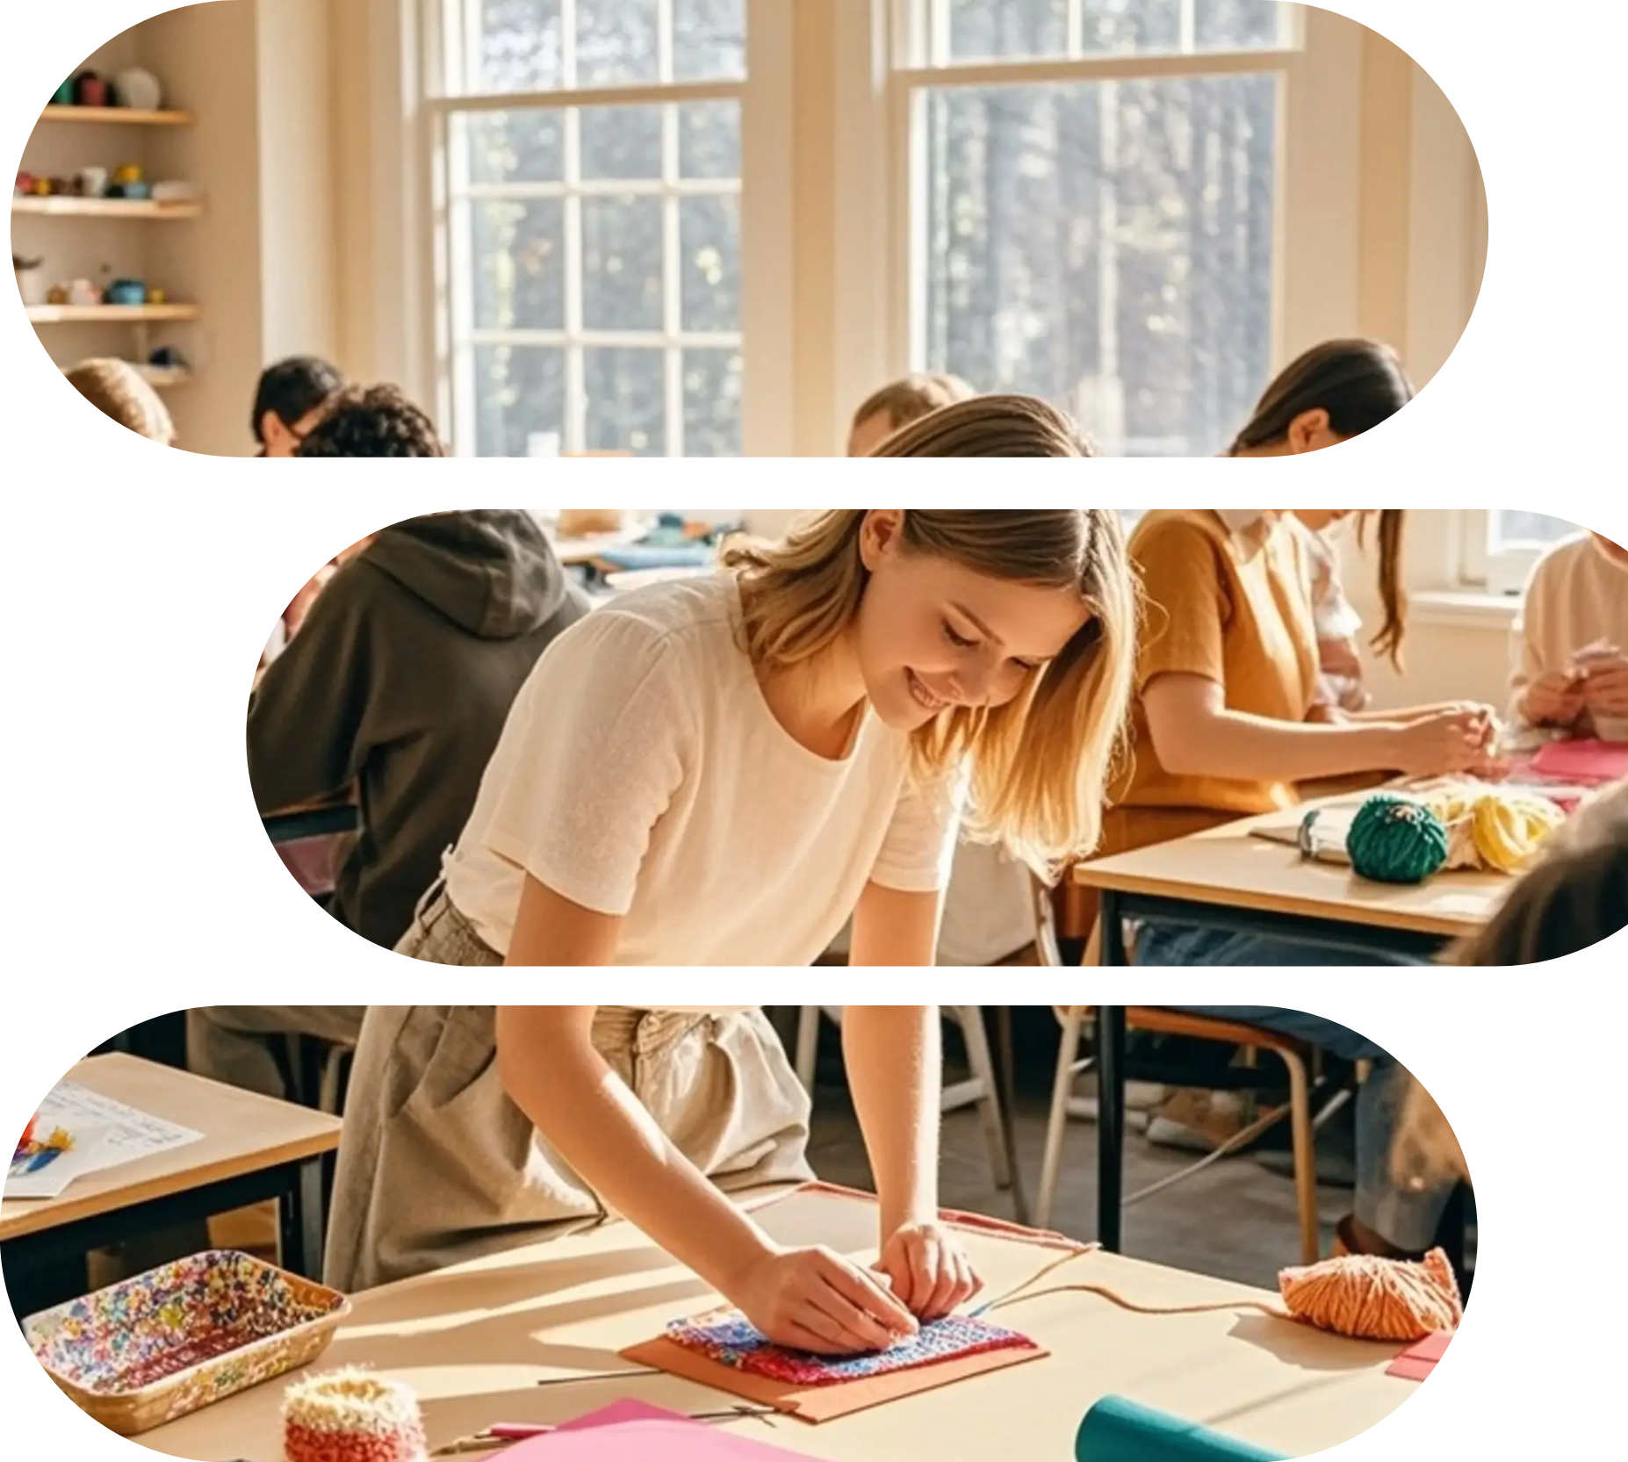







DEFINITION
PRESERVING
CULTURE
AND
HISTORICAL
MEMORY
HANDICRAFT LEARNING
Definition and Value of Handicraft Learning
HANDICRAFT
Introduction
Cultivating patience and concentration
Handicraft learning is the process of creating objects by hand, integrating skills, creativity, and traditional cultural heritage. From Chinese ceramics and embroidery to European glasswork and carpentry, handicraft skills carry the development of human civilization.

Slide 2















CRAFT PHILOSOPHY
01
The Microscopic World of Clay: Clay is primarily composed of tiny,
PATIENCE IS THE ARTISAN'S FIRST VIRTUE
02
When mixed with water, water molecules enter between the mineral layers
03
Upon drying, water evaporates, particles draw closer
Beginning in the mid-18th century, the Industrial Revolution, centered on machine production, led to an explosive increase in productivity and an immense abundance of goods. Standardized, interchangeable parts made mass production possible, drastically reducing costs and bringing many items once enjoyed only by the aristocracy into ordinary households. However, this process also brought about profound alienation. Karl Marx pointed out that workers were alienated into cogs in the production line, estranged from the products of their labor, the labor process, their own species-essence, and even other workers. In the realm of handicraft, this manifested as the "separation of hand and heart." Artisans were no longer the full-process creators of a piece but might merely be operators repeating a single monotonous procedure. The personality, emotional warmth, and maker's imprint of the product were greatly diminished. The value of craft was once reduced to pure practicality and economic efficiency.
It is a choice for sustainable and ethical consumption. People are increasingly concerned about a product's origin, the well-being of its producers, and its environmental footprint. Handmaking is often associated with small-scale, transparent, and eco-friendly production methods.
It is a bridge connecting the digital and physical worlds. Modern artisans skillfully use digital tools for design, marketing, and community building, yet the final realization still relies on the skill of their hands. Craft becomes a hybrid practice integrating ancient wisdom and modern technology.
Introduction
HANDICRAFT LEARNING

Slide 3
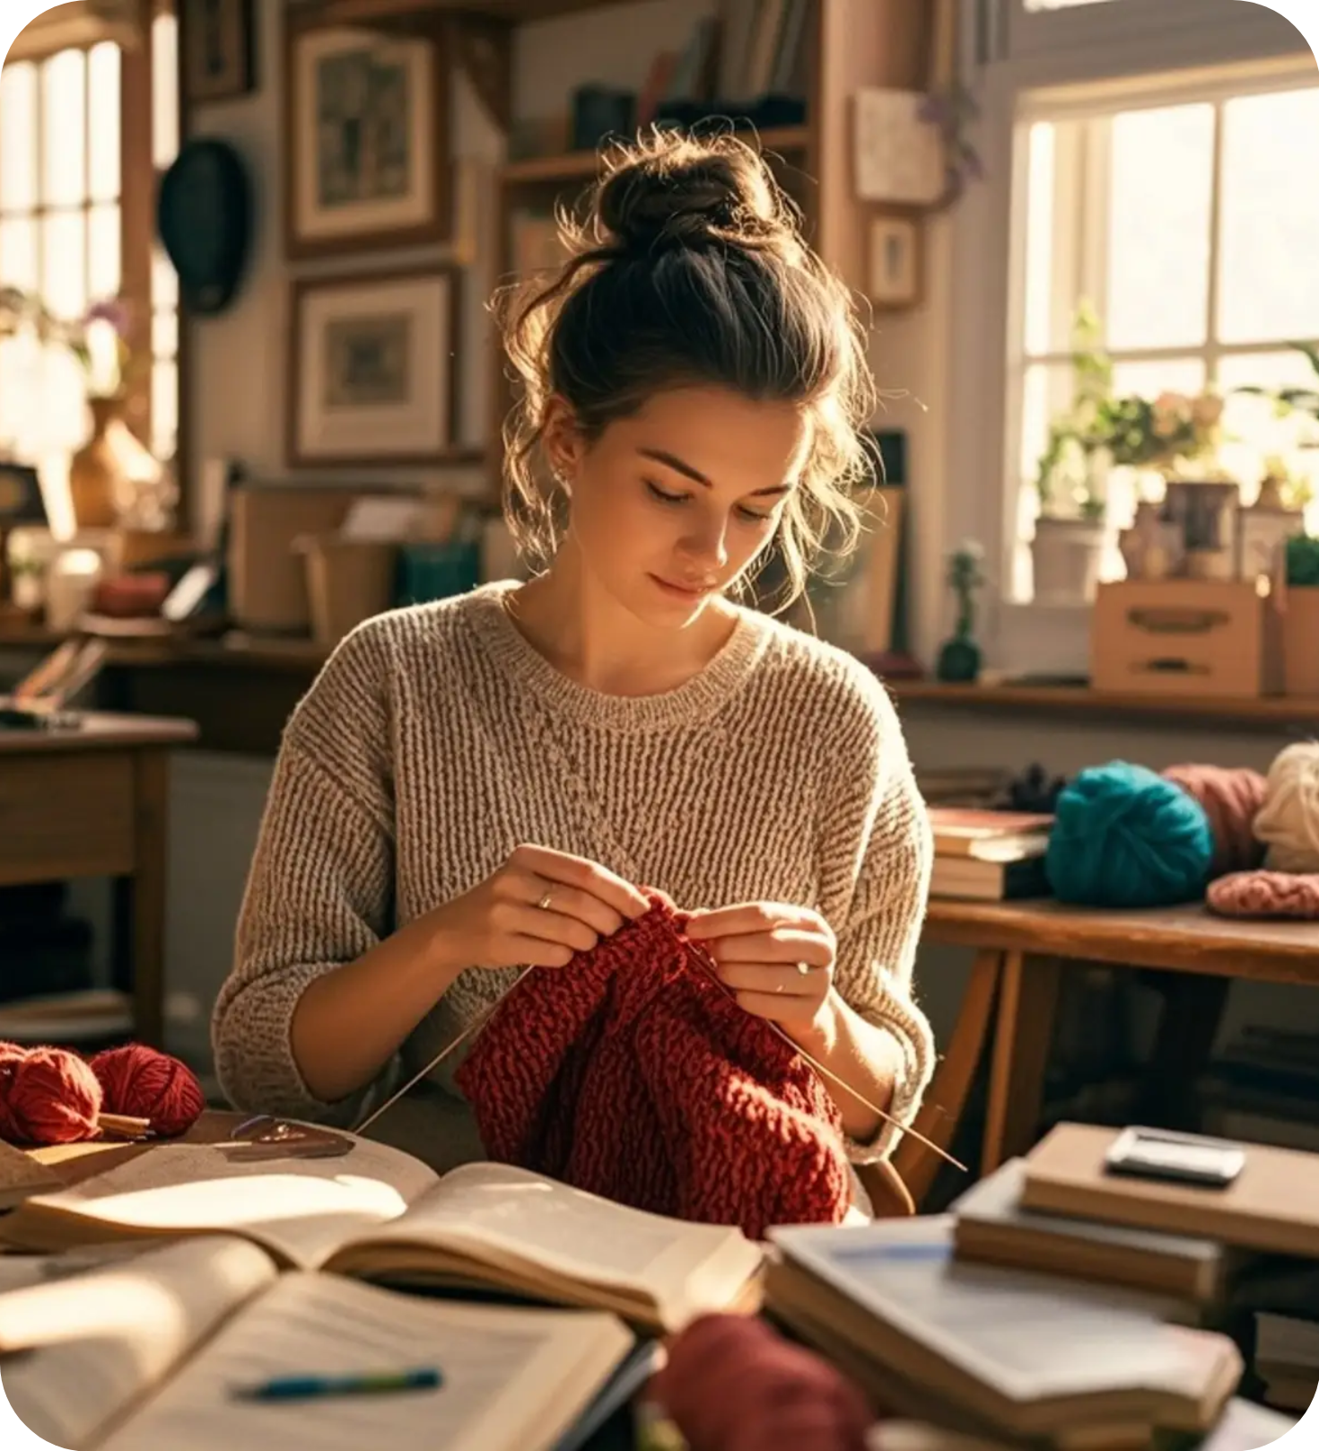





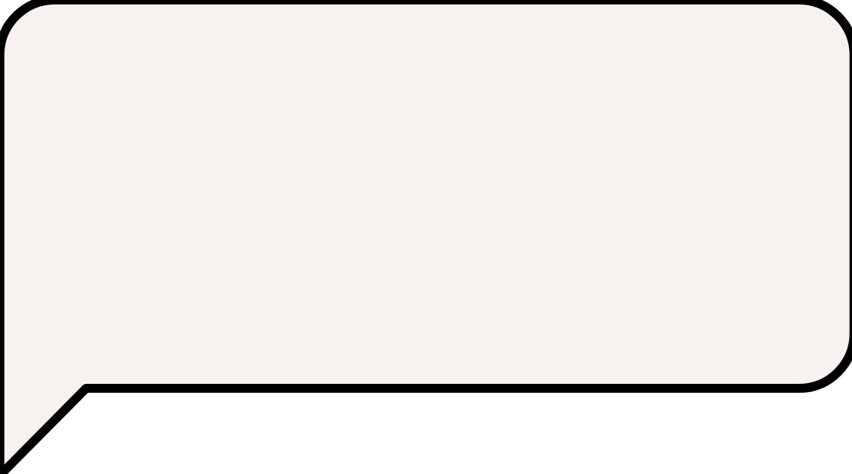













Therefore, contemporary handicraft learning is not only about acquiring a livelihood skill or a hobby but also about learning an aesthetics of existence—a way to understand the world
RESPECT MATERIALS
COST CONTROL
Handicraft learning is the process of creating objects by hand, integrating skills, creativity, and traditional creating objects by hand, integrating skills, creativity, and traditional creativity, and traditional creating objects by hand, integrating skills, creativity, and traditional
Chinese "A craftsman must sharpen his tools first": This reflects profound instrumental rationality and systems thinking. Traditional Chinese craftsmanship
SAFETY ALWAYS COMES FIRST
Introduction
HANDICRAFT LEARNING

Slide 4



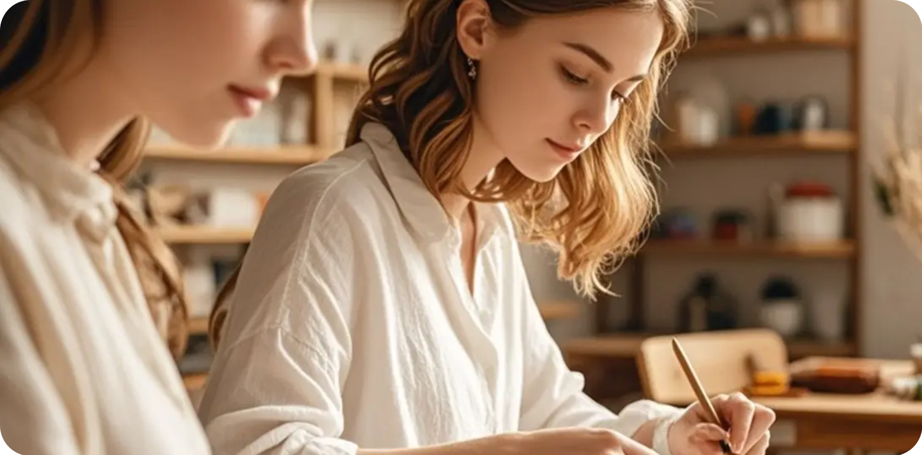


CRAFT CONNECTS PAST AND FUTURE
CRAFTSMANSHIP RESISTS FORGETTING
Creative Inspiration
Exploring Natural Glazes: This is creation directly connected to the earth. Collecting locally sourced, mineral-rich rocks
Introduction
HANDICRAFT LEARNING

Slide 5
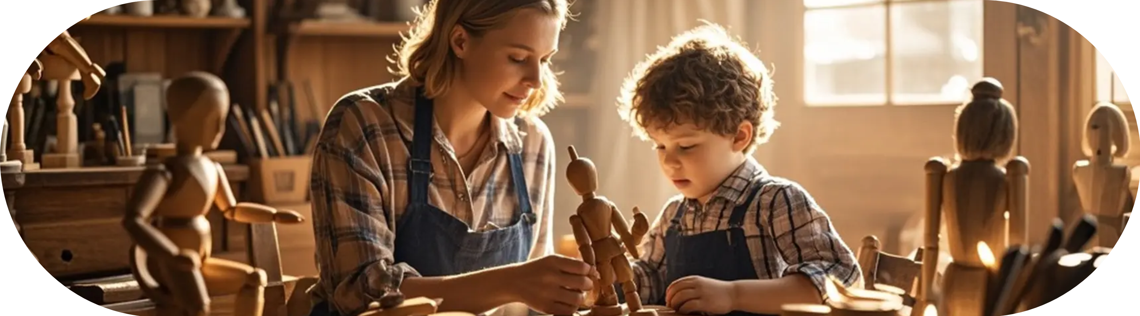


DEFINITION
PRESERVING
CULTURE
AND
HISTORICAL
MEMORY
HANDICRAFT LEARNING
CRAFTING IS A LOVE LETTER TO YOURSELF
Start with small items that have simple designs and clear functions, completing the entire cycle of design - material selection
Cutting Board: Practice straight cuts, surface sanding, and food-safe finishing (e.g., mineral oil).
Wall Shelf: Introduces concepts of right angles and leveling, practicing precise measurement and assembly.

Slide 6

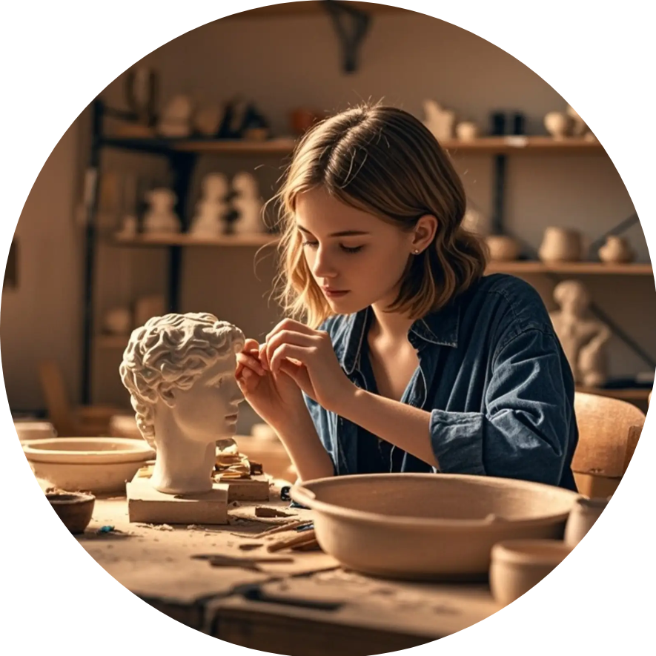












LET YOUR HANDS TELL CREATIVE STORIES
ART FLOWING FROM YOUR FINGERTIPS
Pottery Wheel: The most challenging and enchanting method. Using the centrifugal force generated by a rapidly spinning wheel, combined with hand actions like lifting, pulling, pressing, and expanding, a lump of clay is "summoned" into a symmetrical vessel. This requires perfect coordination of hands, eyes, body, and tools, and a keen perception of the clay's dynamics in motion. Learning to throw on the wheel is a profound practice of constant failure, adjustment, and ultimately achieving "unity of mind and hand.”
Coil Building: Rolling clay into uniform long coils, then stacking and joining them layer by layer to build a form. This method allows for creating large
REPAIR CULTURE
28%
DURABLE DESIGN
19%
LOCAL MATERIALS
88%
Copper oxide produces greens or reds (depending on kiln atmosphere)
Such as sodium oxide, potassium oxide, calcium oxide, etc.
Source of Color and Effects: Metal oxides are the magicians of glaze color.
Introduction
HANDICRAFT LEARNING

Slide 7

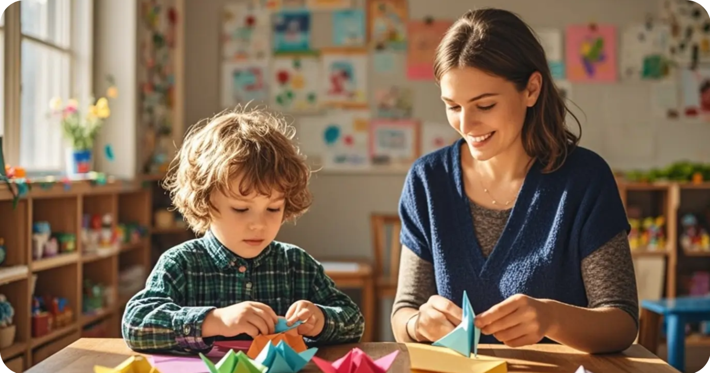


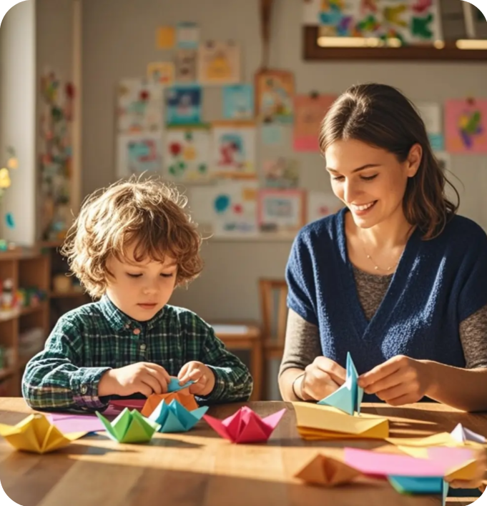



PUTTING ON SAFETY GLASSES
PERSONAL PROTECTIVE EQUIPMENT (PPE) AS RITUAL
01
Before cutting your first piece of wood, spend time observing and learning.
Pinch Pottery: The oldest, most direct method. Shapes are formed entirely by finger pressure, suitable for small, organic forms (e.g., bowls, cups, small sculptures). It requires the creator to maintain a continuous "tactile dialogue" with the clay, feeling its thickness, moisture, and yield point. This is the best way to cultivate a "feel for clay.”
02
The grain of different tree species determines their strength, workability
The Microscopic World of Clay: Clay is primarily composed of tiny, plate-like silicate minerals (e.g., kaolinite). When mixed with water,
03
The moisture content of wood directly affects whether the finished product
Introduction
HANDICRAFT LEARNING

Slide 8

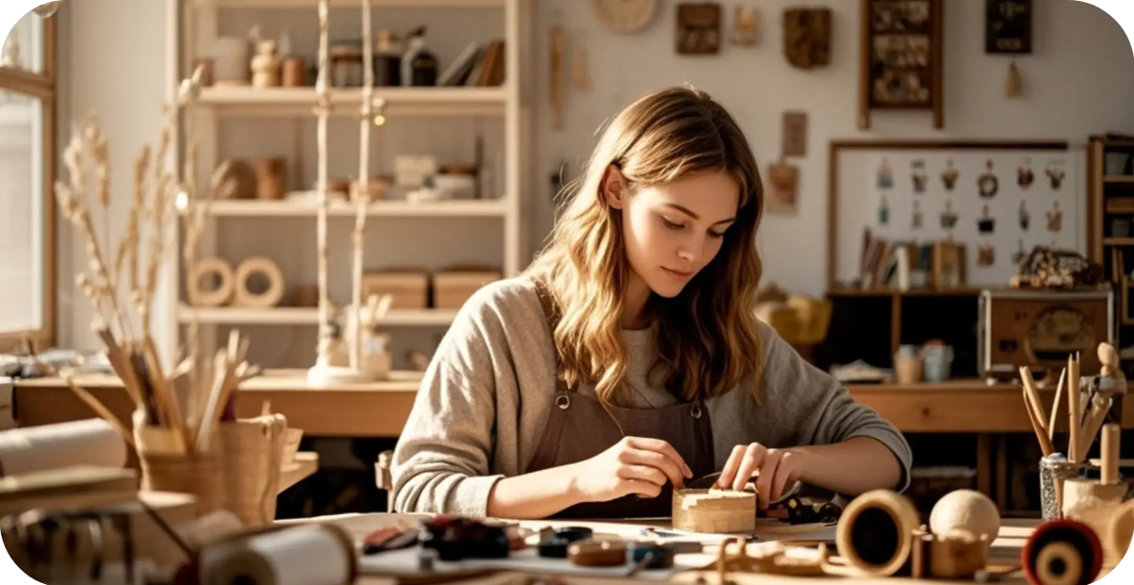



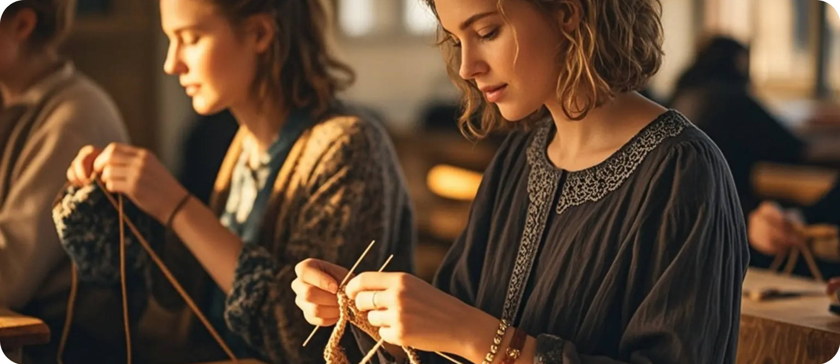



THE "CHARACTER" OF TOOLS
ECO-FRIENDLY PRACTICE
Satin Stitch
French Knot
For filling small areas, creating smooth color blocks.
For creating dotted textures, like flower centers or decorative dots.
Learning Points:
Setting up the warp with even tension; practicing the basic action of passing the weft over and under
World Textile Traditions
Textile arts are among humanity's oldest crafts; a single thread connects civilization, identity, and art.
Introduction
HANDICRAFT LEARNING

Slide 9
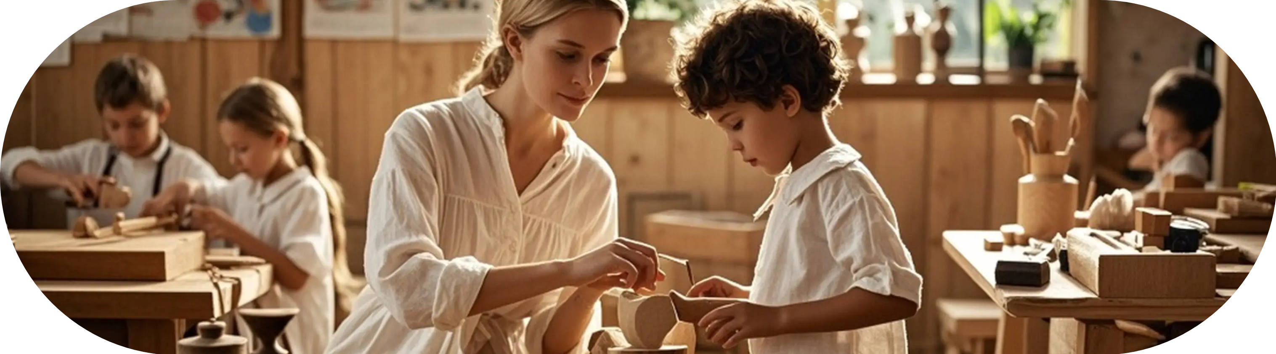

DEFINITION
PRESERVING
CULTURE
AND
HISTORICAL
MEMORY
HANDICRAFT LEARNING
COMMUNITY HEALING PROJECT CASES
Knitting groups are established for people experiencing grief, illness, or social isolation. The repetitive motions bring calm, group sharing fosters a sense of belonging, and the final completed blankets or items are donated to charity, transforming personal healing into care for others and imbuing the process with deeper meaning.

Slide 10


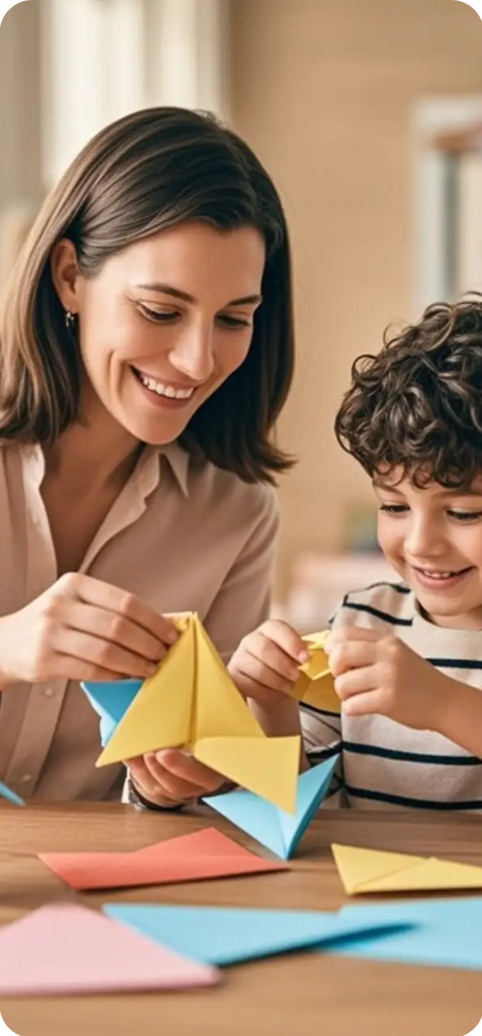
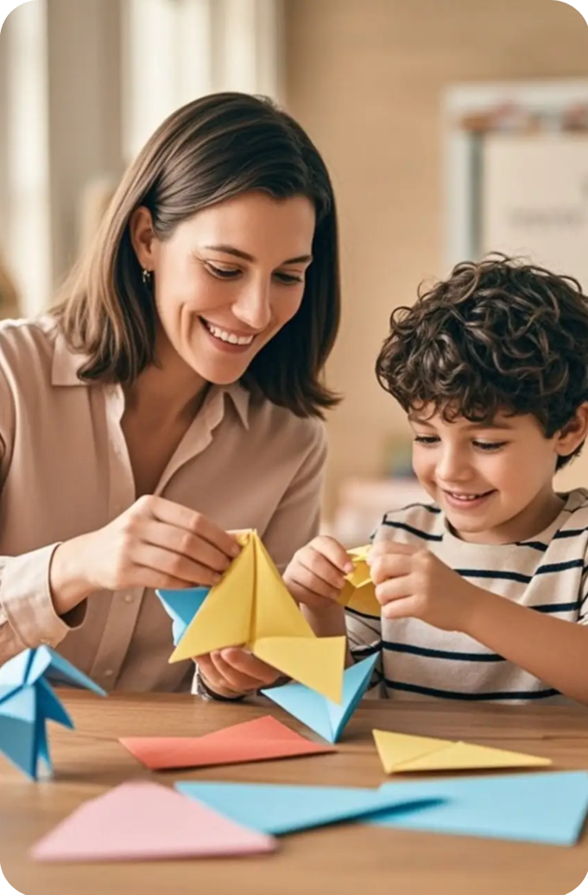




HANDICRAFT LEARNING
TRADITION IS THE FOUNDATION FOR INNOVATION
Sense of Volume
Texture Expression
Pinch Pottery: The oldest, most direct method. Shapes are formed entirely by finger pressure, suitable for small, organic forms (e.g., bowls, cups, small sculptures). It requires the creator to maintain a continuous "tactile dialogue" with the clay, feeling its thickness, moisture, and yield point.
The Magic of Firing: High temperatures inside the kiln (typically above 600°C) trigger profound chemical changes. Silicate minerals begin to vitrify, particles fuse together, forming a hard, permanent, waterproof ceramic body. During this process, organic matter is burned off, water of crystallization is driven out
Introduction
HANDICRAFT LEARNING

Slide 11




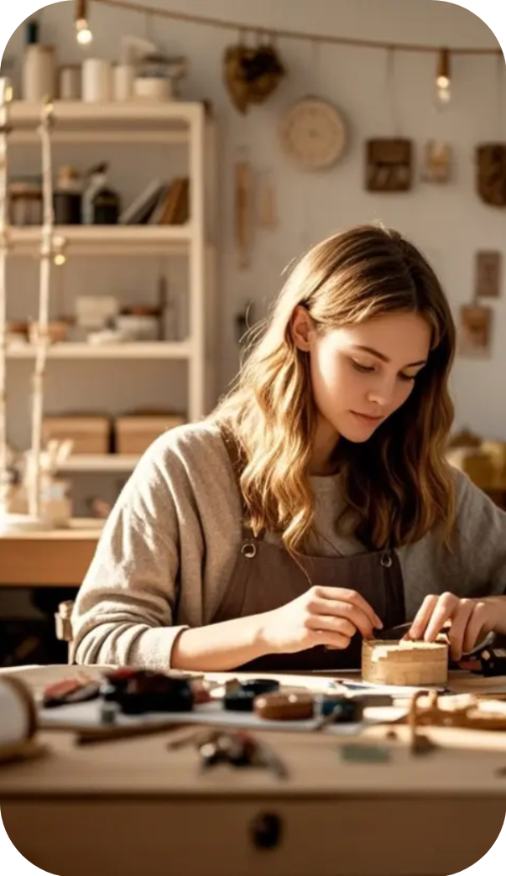
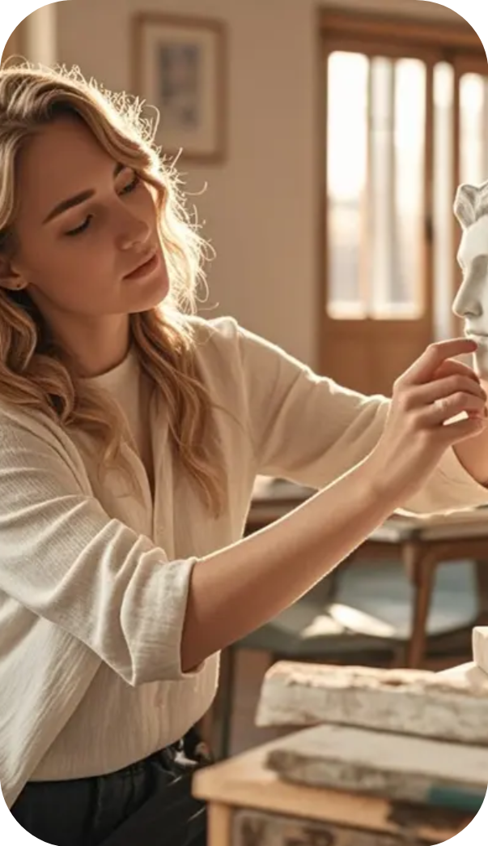



















REPEATED REFINEMENT
CREATIVE INSPIRATION
CAST ON
58%
STOCKINETTE STITCH
39%
Paper Geometry
Wet-Folding
Modular Origami
Infinite possibilities from one sheet
Precision in creasing determines success
Mathematical beauty in folding
"Zero Waste" Design: During the design phase, consider how to maximize the use of lumber and minimize waste. Generated sawdust and shavings can be used
Patience
Mistakes
Knitting
Introduction
HANDICRAFT LEARNING

Slide 12


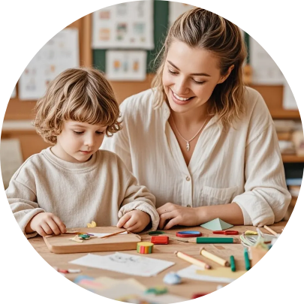
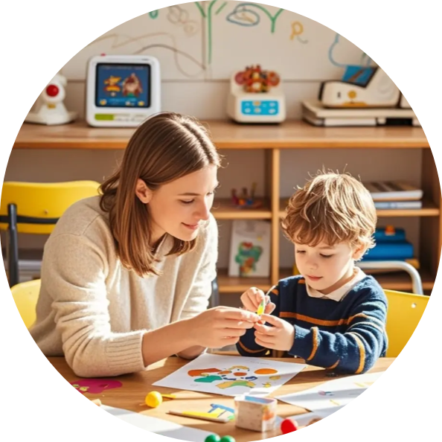



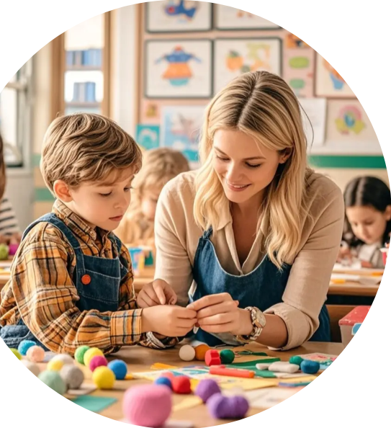

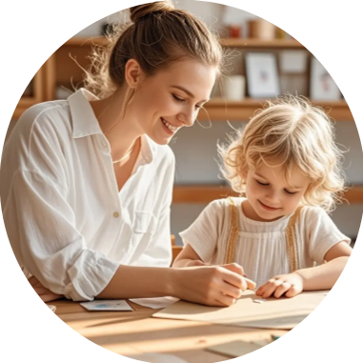


HAND-EYE COORDINATION
FROM ZERO TO ONE
Safety First Philosophy: Building a Relationship of Respect with ToolsIn the world of woodworking, safety is not a set of rigid rules but a core ethic of craftsmanship and a state of mind. The root cause of every accident is often not the tool itself, but the user's distraction, recklessness, or misunderstanding of the tool. The "Character" of Tools: Every tool has its designed purpose, range of power, and "temperament." A circular saw craves straight cuts but will violently resist torque; a chisel needs precise guidance and gentle taps; a handsaw relies on the user's rhythm and endurance. The first step in learning woodworking is to understand your tools like you would a partner: Where is its cutting edge? What might its reactive force be? How do you properly hold, adjust, and maintain it?
Personal Protective Equipment (PPE) as Ritual: Putting on safety glasses, a dust mask, and hearing protection is not just physical safeguarding; it is a ritual for mental transition. It marks your shift from an everyday state into the "workshop zone" that demands high concentration and respect. Keeping the work area tidy, bright, and free of clutter is also part of safety culture.
Progressive Learning Path
Introduction
HANDICRAFT LEARNING

Slide 13
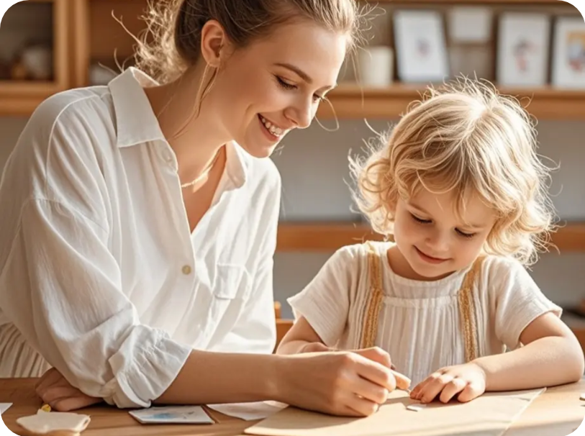
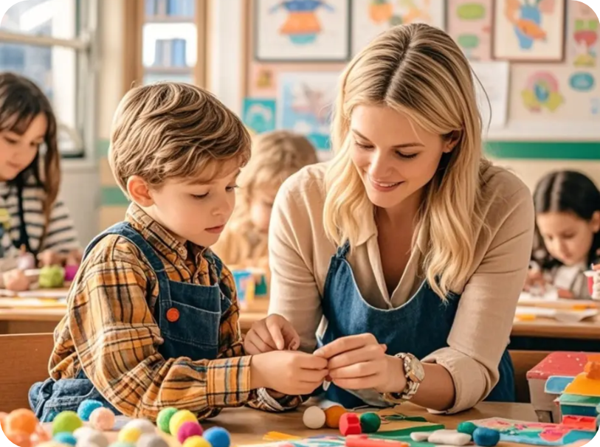
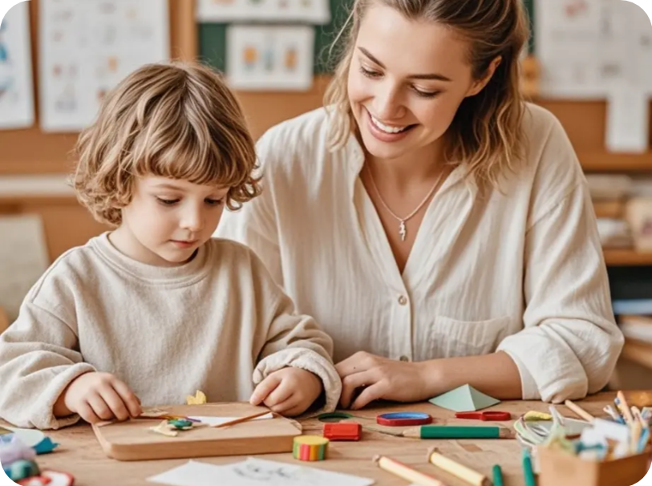
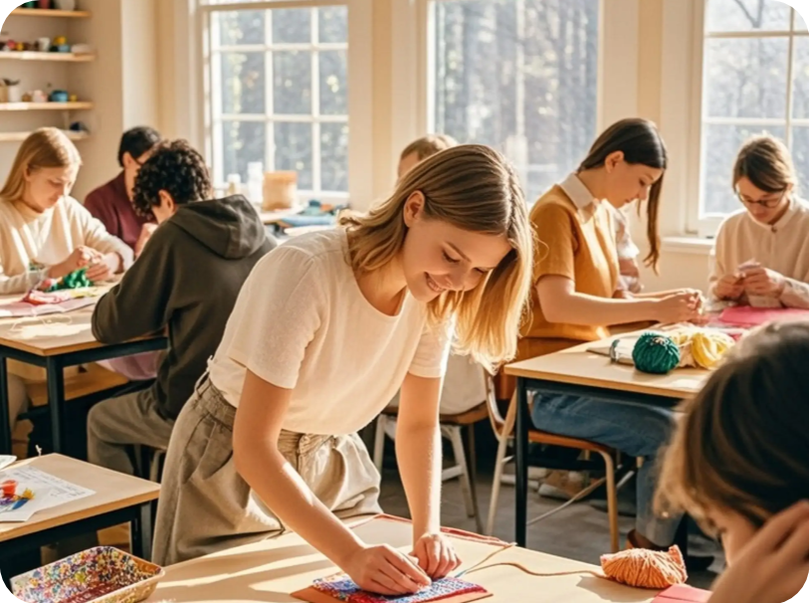














PROGRESSIVE LEARNING PATH
Mechanical Fasteners
DIALOGUING WITH WOOD
Screws, dowels, biscuit joiners. They are fast and strong; knowing when and how to use them is a pragmatic choice.
Cultivating patience
Handicraft learning is the process of creating objects by hand, integrating skills, creativity, and traditional
A
B
C
D
Direct Carving
Modeling
Direct Carving
Carving Chisel
Every handprint is a signature
Tradition is the foundation for innovation
Hands connect heart and world
Constraints spark creativity
Introduction
HANDICRAFT LEARNING

Slide 14
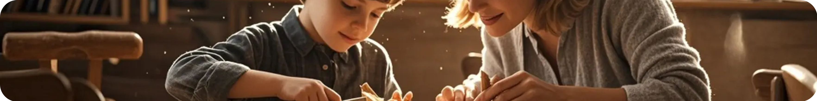





01
Subtractive Method
Such as sodium oxide, potassium oxide, calcium oxide, etc., used to lower the melting point of silica so it can melt at achievable kiln temperatures.
PATIENCE IS THE ARTISAN'S FIRST VIRTUE
PROGRESS HIDES IN EVERY PRACTICE
02
Additive Method
Glaze is a vitreous coating applied to the surface of a ceramic body, imparting color, luster, texture, and practicality
Introduction
HANDICRAFT LEARNING

Slide 15
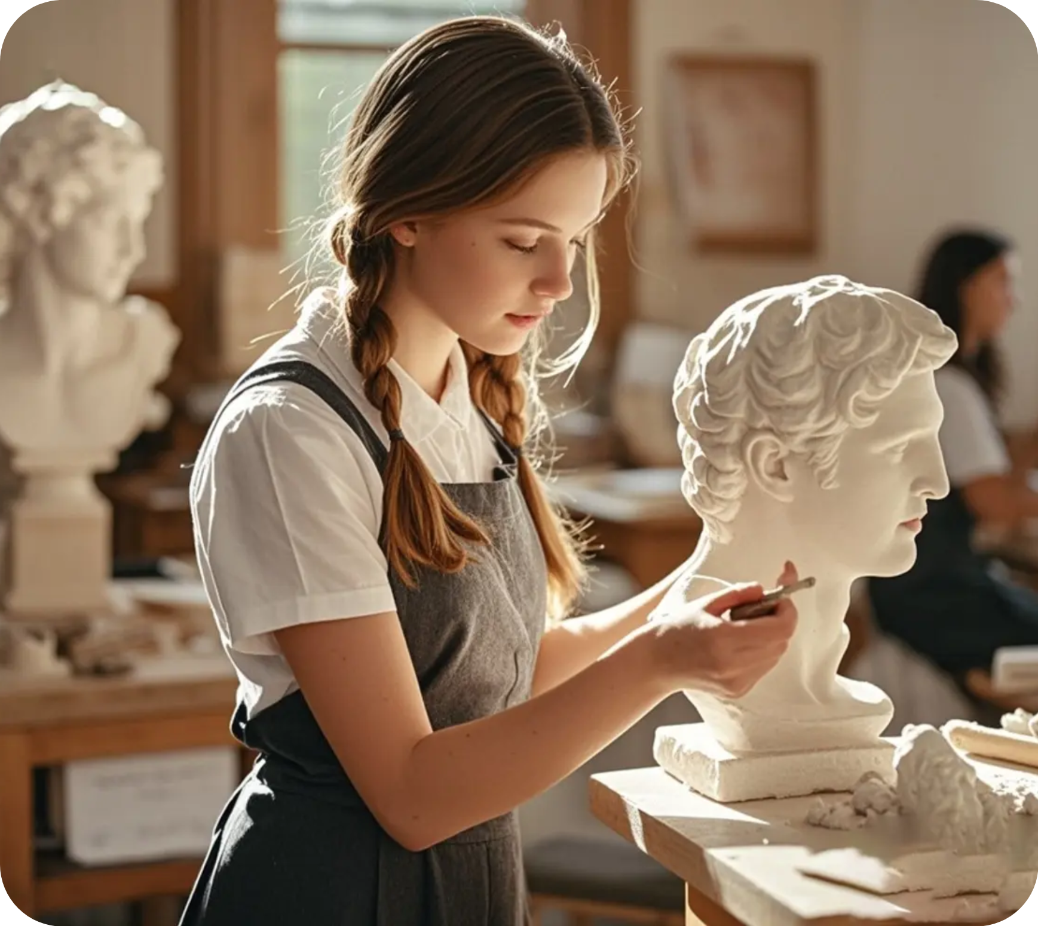


DEFINITION
PRESERVING
CULTURE
AND
HISTORICAL
MEMORY
HANDICRAFT LEARNING
Definition and Value of Handicraft Learning
VISUAL
The initial materials were tree bark, hemp ends, rags, and old fishing nets, producing paper that was both tough and inexpensive, laying the foundation for the widespread dissemination of knowledge and culture.

